Slide 1

Modern Asymmetric-Key Ciphers: Principles
CHAPTER 8

Slide 2
Outlines
Asymmetric-Key (Public-Key) Cryptography vs Symmetric-Key (Private-Key) Cryptography.
Principles in Asymmetric-Key Cryptography Design.
Trapdoor One-Way Function.

Slide 3
Learning Objectives
In the end of this Chapter 8, students will be able:
To understand and differentiate between symmetric-key (private-key) cryptography and asymmetric-key (public-key) cryptography.
To understand the principles in designing public-key cryptography and its application with respect to different security objectives.
To understand the trapdoor one-way function and its importance to public-key cryptography.

Slide 4
Asymmetric-Key Cryptography vs Symmetric-Key Cryptography

Slide 5
Symmetric-Key Cryptography
Recall that in symmetric-key cryptography, it uses one private key in encryption and decryption operations.
This same private key (hence symmetric) is shared between the sender and the receiver. If this key is disclosed to the attacker, hence the cryptosystem is compromised.
It has been implemented from ancient to modern times (including current time), in both the block and stream ciphers via substitution and/or permutation (transposition).
This symmetric-key cryptography DOES NOT protect the integrity and non-repudiation properties in security.

Slide 6
Asymmetric-Key Cryptography
In contrast to symmetric-key cryptography, asymmetric-key cryptography uses two different keys (one public key and one private key, hence asymmetric) in encryption and decryption operations, respectively.
Anyone can obtain such public key for encryption or verifying purposes, but can NEVER able to decrypt or sign the message without the corresponding private key.
It is probably the most significant advancement in the 3000 years of history of cryptography through the clever application of number theory.
It complements rather than replaces symmetric-key cryptography.

Slide 7
Asymmetric-Key Cryptography: basic concepts & design principles

Slide 8
Asymmetric-Key Cryptography
Why public-key cryptography is important (Why do we need it)?
It is developed to address two key issues associated with symmetric cryptography.
Key Distribution Problem. To establish a secure communication in general without having to trust a Key Distribution Center.
Message Integrity. To verify a message that comes intact from the claimed sender.
The very first practical public-key cryptosystem was published by Whitfield Diffie and Martin Hellman in 1976, which realized the idea of Key Distribution (named the Diffie-Hellman Key Exchange, DHKE).

Slide 9
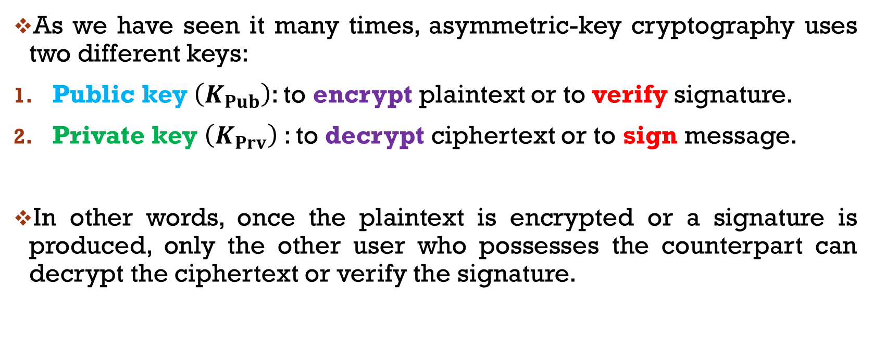
basic concepts
As we have seen it many times, asymmetric-key cryptography uses two different keys:
Public key $\left(K_{Pub}\right)$: to encrypt plaintext or to verify signature.
Private key $\left(K_{Prv}\right)$: to decrypt ciphertext or to sign message.
In other words, once the plaintext is encrypted or a signature is produced, only the other user who possesses the counterpart can decrypt the ciphertext or verify the signature.

Slide 10
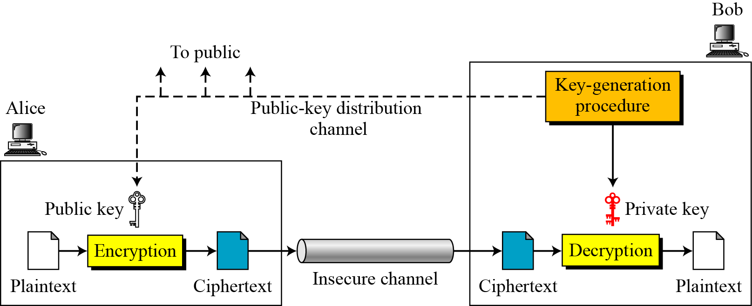
basic concepts

Slide 11
basic concepts
Unlike symmetric-key cryptography that applies to any forms of plaintext (alphabets, bits, bytes, hexadecimals, etc.), the plaintext and ciphertext are treated as integers (decimals) in asymmetric-key cryptography.
Hence, plaintext and ciphertext must be encoded into integers before encryption and decryption, respectively.

Slide 12
Design principles
The design principles of asymmetric-key cryptography rely on the following security objectives:
To provide confidentiality.
The key pair is generated by the receiver, with private key known only to receiver while public key is known to everyone.
To provide authentication.
The key pair is generated by the sender, with private key known only to sender while public key is known to everyone.
To provide both confidentiality and authentication.
Key pairs are generated by both sender and receiver.

Slide 13
Design principles – confidentiality

Slide 14
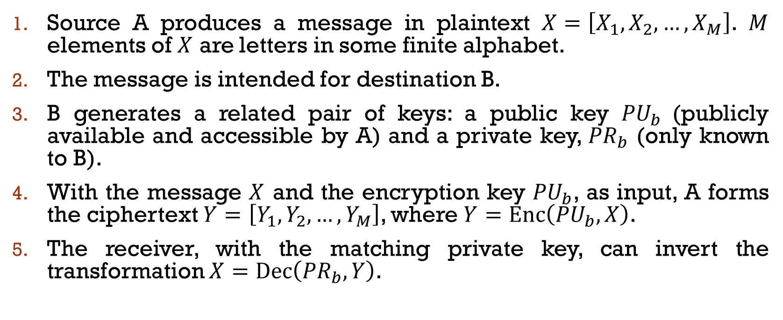
Design principles – confidentiality
Source A produces a message in plaintext $X=\left[X_{1},X_{2},…,X_{M}\right]$. $M$ elements of $X$ are letters in some finite alphabet.
The message is intended for destination B.
B generates a related pair of keys: a public key ${PU}_{b}$ (publicly available and accessible by A) and a private key, ${PR}_{b}$ (only known to B).
With the message $X$ and the encryption key ${PU}_{b}$, as input, A forms the ciphertext $Y=\left[Y_{1},Y_{2},…,Y_{M}\right]$, where $Y=Enc\left({PU}_{b},X\right)$.
The receiver, with the matching private key, can invert the transformation $X=Dec\left({PR}_{b},Y\right)$.

Slide 15
Design principles – authentication

Slide 16
Design principles – authentication
Source A prepares a message to B and encrypts it using A’s private key before transmission.
B can decrypt the message using A’s public key.
The entire encrypted message serves as a digital signature.
Message is authenticated in terms of source and in terms of data integrity.
Since the message was encrypted using A’s private key, only A could have prepared the message and impossible to alter the message by others.
This does not provide confidentiality since any observer can decrypt the message by using the sender’s public key.

Slide 17
Design principles – confidentiality & authentication

Slide 18
Design principles – confidentiality & authentication
Here the receiver owns and creates secrecy keys, sender owns and creates authentication keys.
Encryption of message done using sender’s private key. This provides authentication.
This output is encrypted again using the receiver’s public key to provide final ciphertext.
This final ciphertext can be decrypted only by the corresponding receiver, who has the matching private key. This provides confidentiality.
Disadvantage: The computational cost is high since the public-key algorithm must be executed four times.

Slide 19
applications
There are three main applications of asymmetric-key cryptography:
Encryption/Decryption (Confidentiality)
Sender encrypts a message with the recipient's public key.
Digital Signature (Authentication)
The sender “signs” a message with its private key, either to the whole message or to a small block of data that is a function of the message.
Key Exchange
Two sides cooperate to exchange a session key

Slide 20
applications
Some algorithms are suitable for all the three applications, while others are specific to only one or two purposes.

Slide 21
trapdoor One-way function

Slide 22
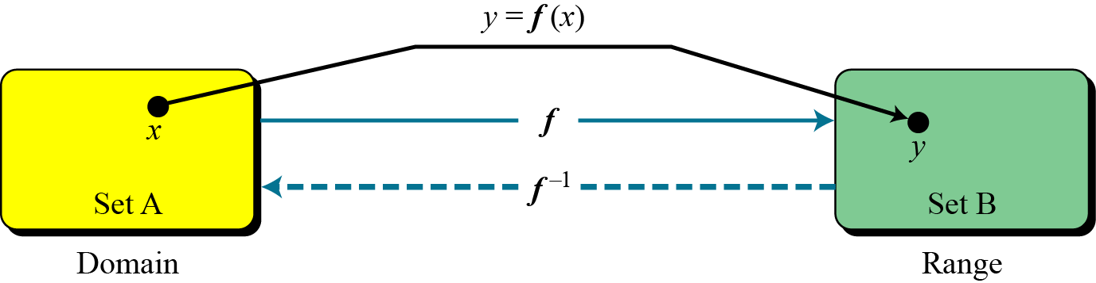
function
The underlying foundation of asymmetric-key cryptography is the concept of trapdoor one-way function.
A function is a map on input of an element in the domain, outputs another element in the range.
A function is invertible if it maps exactly one element in the range to one element in the domain.

Slide 23
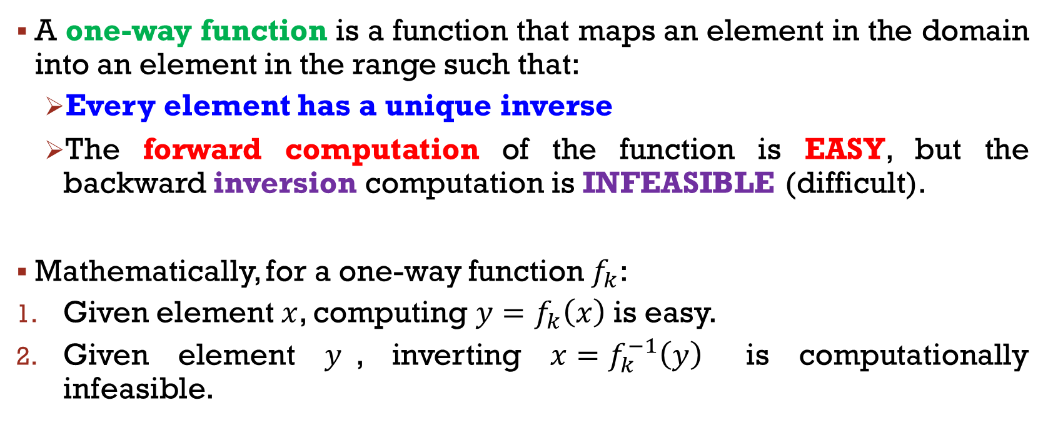
One-way function
A one-way function is a function that maps an element in the domain into an element in the range such that:
Every element has a unique inverse
The forward computation of the function is EASY, but the backward inversion computation is INFEASIBLE (difficult).
Mathematically, for a one-way function $f_{k}$:
Given element $x$, computing $y=f_{k}\left(x\right)$ is easy.
Given element $y$, inverting $x=f_{k}^{−1}\left(y\right)$ is computationally infeasible.

Slide 24
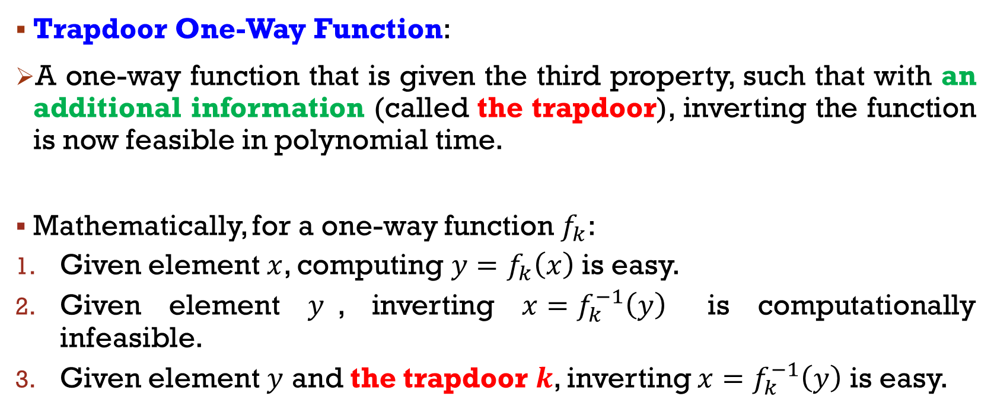
trapdoor One-way function
Trapdoor One-Way Function:
A one-way function that is given the third property, such that with an additional information (called the trapdoor), inverting the function is now feasible in polynomial time.
Mathematically, for a one-way function $f_{k}$:
Given element $x$, computing $y=f_{k}\left(x\right)$ is easy.
Given element $y$, inverting $x=f_{k}^{−1}\left(y\right)$ is computationally infeasible.
Given element $y$ and the trapdoor $k$, inverting $x=f_{k}^{−1}\left(y\right)$ is easy.

Slide 25
trapdoor One-way function
Some famous examples of o trapdoor one-way functions that we used in cryptography (and we will learn it in the next chapter):
Integer Factorization Problem (IFP). The core security of the RSA cryptosystem.
Discrete Logarithm Problem (DLP). The fundamental strength of the Diffie-Hellman Key Exchange, and the ElGamal cryptosystem.
Knapsack Problem (A family of Subset Sum Problem (SSP)). The heart of the Knapsack cryptosystem.

Slide 26
Main References for Chapter 8
Forouzan, B.A. “Introduction to Cryptography and Network Security”, Third Edition, McGraw-Hill, 2008.
Stallings, W. “Cryptography and Network Security: Principles and Practices”, Fifth Edition, Pearson Prentice Hall, 2011.

Slide 27
~ THE END ☺ ~

